Slide 1
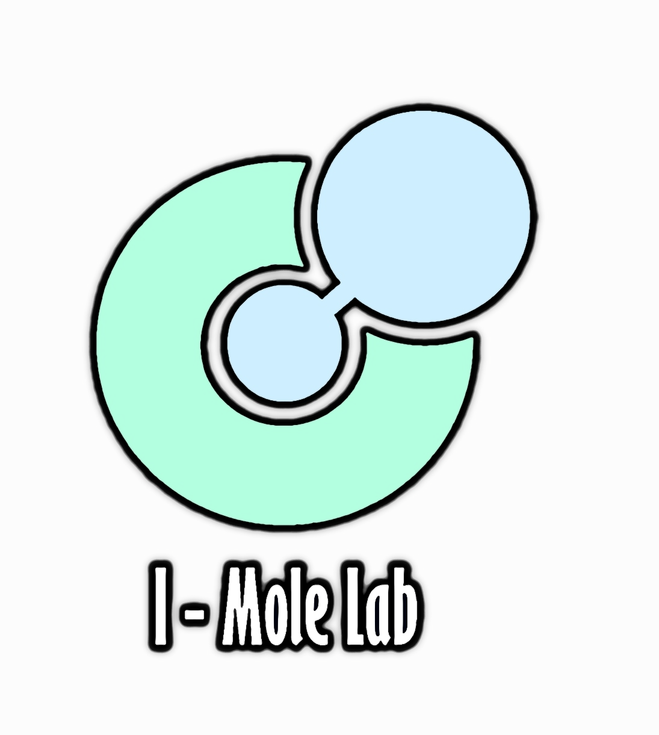
Notes:
GitHub is a development platform that enables you to host and review code, manage projects, and build software alongside 50 million developers.
Why is everyone building on GitHub? Because it provides the important DevOps features companies and organizations of all sizes need for their public and private projects. Whether it's planning features, fixing bugs, or collaborating on changes, GitHub is the place where the world's software developers gather to make things. And then make them better.
In this module, you learn to use key GitHub features, including issues, notifications, branches, commits, and pull requests.

Slide 2

Ahmed Tarek
Benha University ( Medical informatics)
Mentor at GSSoC ( open source program )
Interested in Data science
Have a good knowledge in Cloud and DevOps
LinkedIn : ahmed tarek | LinkedIn

Slide 3

Prerequisites
A GitHub account

Slide 4
Learning objectives
Open a repo
Create a branch
Commit changes to the branch
Create a pull request
Merge the pull request

Slide 5

Agenda
Introduction
What is GitHub?
Look at GitHub Website
Use GitHub Desktop
Look at open source project

Slide 6
Introduction

Slide 7

Introduction
GitHub is a development platform that enables you to host and review code, manage projects, and build software alongside 50 million developers.
Notes:
GitHub is a development platform that enables you to host and review code, manage projects, and build software alongside 50 million developers.
Why is everyone building on GitHub? Because it provides the important DevOps features companies and organizations of all sizes need for their public and private projects. Whether it's planning features, fixing bugs, or collaborating on changes, GitHub is the place where the world's software developers gather to make things. And then make them better.
In this module, you learn to use key GitHub features, including issues, notifications, branches, commits, and pull requests.

Slide 8
What is GitHub?

Slide 9

The GitHub flow
In addition to providing a platform for collaborative software development, GitHub also offers a workflow designed to optimize use of its various features.
Notes:
In addition to providing a platform for collaborative software development, GitHub also offers a workflow designed to optimize use of its various features. While this unit offers a cursory overview of important platform components, it's recommended that you first review Understanding the GitHub flow.

Slide 10
Git and GitHub
As you work with Git and GitHub, you may wonder about the difference between the two.
Issues
Discussions
Pull requests
Notifications
Labels
Actions
Forks
Projects
Installed and used on your local machine
Handles version control
Supports branching
Notes:
As you work with Git and GitHub, you may wonder about the difference between the two.
Git is a distributed version control system (DVCS) that allows multiple developers or other contributors to work on a project. It provides a way to work with one or more local branches and push them to a remote repository. Git is responsible for everything GitHub-related that happens locally on your computer. Key features provided by Git include:
Installed and used on your local machine
Handles version control
Supports branching
To learn more about Git, see Using common Git commands.
GitHub is a cloud platform that uses Git as its core technology. It simplifies the process of collaborating on projects and provides a website, command-line tools, and overall flow that allows developers and users to work together. GitHub acts as the "remote repository" mentioned previously in the Git section.
Key features provided by GitHub include:
Issues
Discussions
Pull requests
Notifications
Labels
Actions
Forks
Projects
To learn more about GitHub, see Getting started with GitHub.

Slide 11
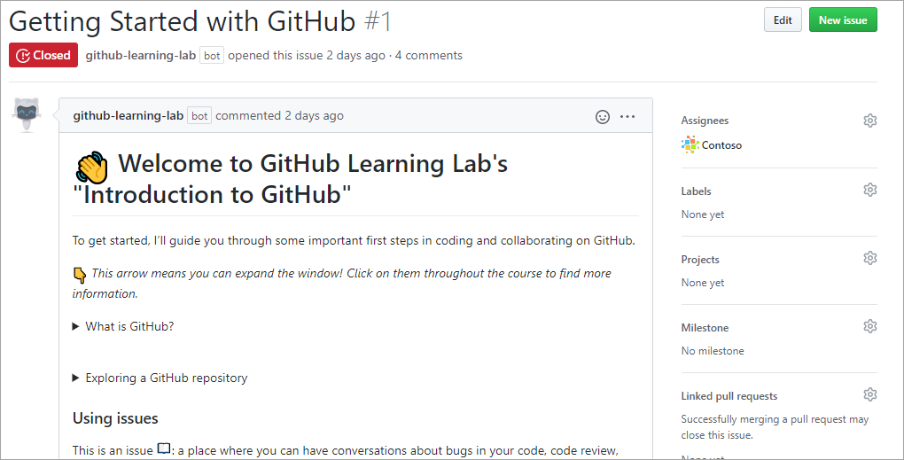
Issues
Issues are where most of the communication between a project's consumers and development team occurs. An issue can be created to discuss a broad set of topics, including bug reports, feature requests, documentation clarifications, and more.
Notes:
Issues are where most of the communication between a project's consumers and development team occurs. An issue can be created to discuss a broad set of topics, including bug reports, feature requests, documentation clarifications, and more. Once an issue has been created, it can be assigned to owners, labels, projects, and milestones. You can also associate issues with pull requests and other GitHub items to provide future traceability.

Slide 12
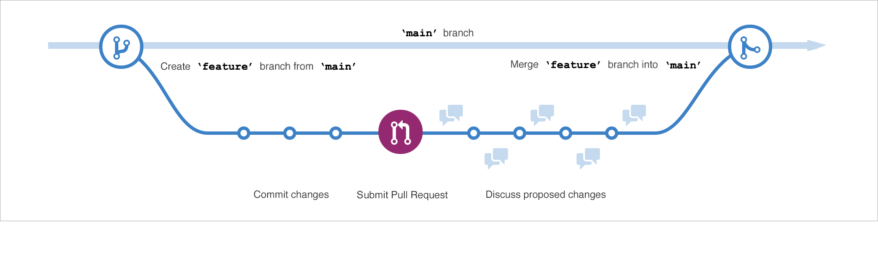
Branches
Branches are the preferred way to create changes in the GitHub flow.
Notes:
Branches are the preferred way to create changes in the GitHub flow. They provide isolation so that multiple people may simultaneously work on the same code in a controlled way. This model enables stability among critical branches, such as main, while allowing complete freedom for developers to commit any changes they need to meet their goals. Once the code from a branch is ready to become part of the main branch, it may be merged via pull request.
To learn more about GitHub branches, see About branches.

Slide 13
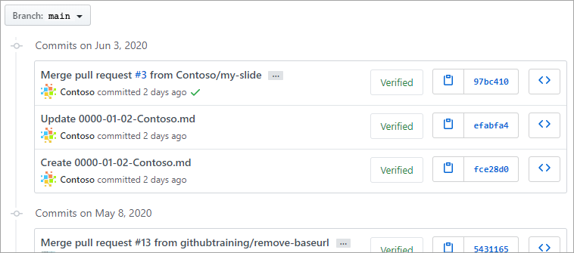
Commits
A commit is a change to one or more files on a branch.
Notes:
A commit is a change to one or more files on a branch. Every time a commit is created, it is assigned a unique ID and tracked, along with the time and contributor. This provides a clear audit trail for anyone reviewing the history of a file or linked item, such as an issue or pull request.
To learn more about GitHub commits, see Committing and reviewing changes to your project.

Slide 14
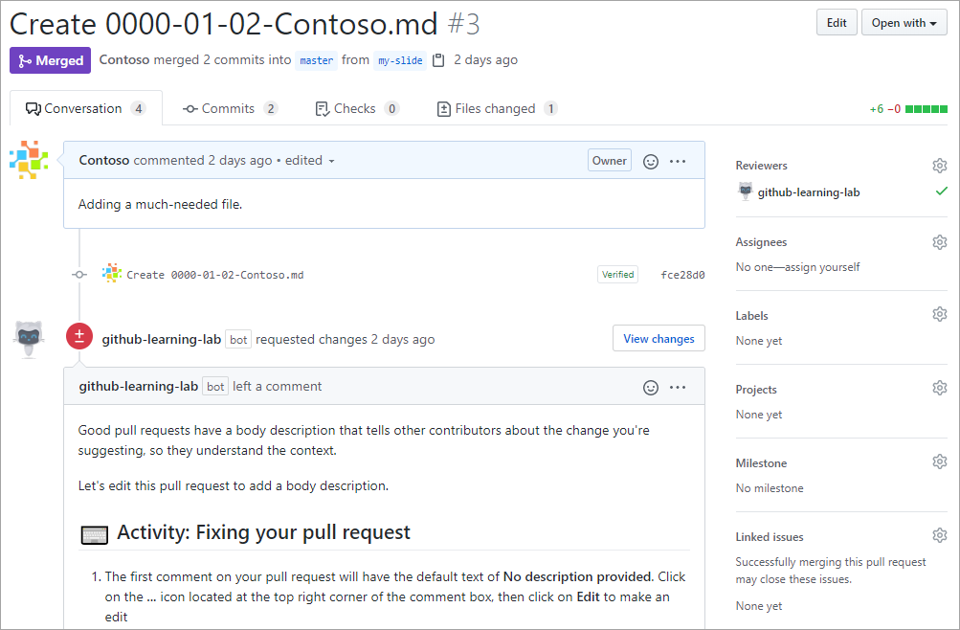
Pull Requests
A pull request is the mechanism used to signal that the commits from one branch are ready to be merged into another branch.
Notes:
A pull request is the mechanism used to signal that the commits from one branch are ready to be merged into another branch. The developer submitting the pull request will often request one or more reviewers to verify the code and approve the merge. These reviewers have the opportunity to comment on changes, add their own, or use the pull request itself for further discussion. Once the changes have been approved (if approval is required), the pull request's source branch (the compare branch) may be merged in to the base branch.
To learn more about GitHub pull requests, see About pull requests.

Slide 15
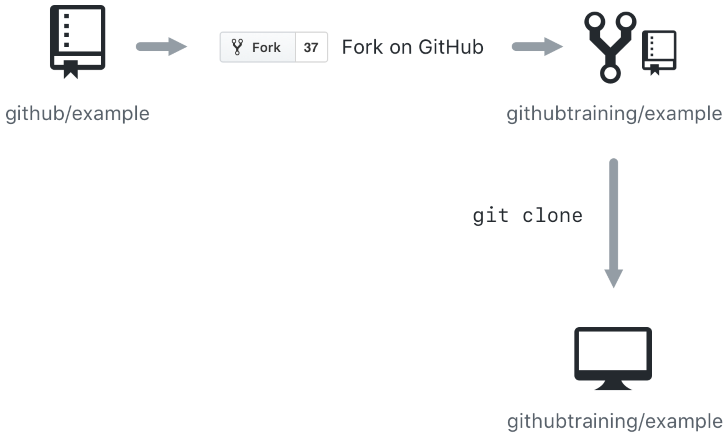
Cloning and forking
GitHub provides multiple ways to copy a repository so that you can work on it.
Cloning a Repository - Cloning a repository will make a copy of the repository and its history on your local machine. If you have write access to the repository you can push changes from your local machine to the remote repository (called the origin) as they're completed. To clone a repository you can use the git clone [url] command or the GitHub CLI's gh repo clone [url] command.
Forking a Repository - Forking a repository makes a copy of the repository in your GitHub account. The parent repository is referred to as the upstream while your forked copy is referred to as the origin. Once you've forked a repository into your GitHub account you can clone it to your local machine. Forking allows you to freely make changes to a project without affecting the original upstream repository. To contribute changes back to the upstream repository you create a pull request from your forked repository. You can also run git commands to ensure that your local copy stays synced with the upstream repository.
Notes:
GitHub provides multiple ways to copy a repository so that you can work on it.
Cloning a Repository - Cloning a repository will make a copy of the repository and its history on your local machine. If you have write access to the repository you can push changes from your local machine to the remote repository (called the origin) as they're completed. To clone a repository you can use the git clone [url] command or the GitHub CLI's gh repo clone [url] command.
Forking a Repository - Forking a repository makes a copy of the repository in your GitHub account. The parent repository is referred to as the upstream while your forked copy is referred to as the origin. Once you've forked a repository into your GitHub account you can clone it to your local machine. Forking allows you to freely make changes to a project without affecting the original upstream repository. To contribute changes back to the upstream repository you create a pull request from your forked repository. You can also run git commands to ensure that your local copy stays synced with the upstream repository.
When would you clone a repository versus fork a repository? If you're working with a repository and have write access you can clone it to your local machine. From there you can make modifications and push your changes directly to the origin repository.
If you need to work with a repository created by another owner such as github/example and don't have write access, you can fork the repository into your GitHub account, and then clone the fork to your local machine. To see this visually, let's assume that your GitHub account is called githubtraining for this example. Using the GitHub website you can fork githubtraining or any other examples into your account. From there you can clone the forked version of the repository to your local machine. These steps are shown in the following image.
Changes can be made to your local copy of githubtraining/example and then pushed back to your remote origin repository (githubtraining/example). The changes can then be submitted to the github/example upstream repository using a pull request as shown next.
To learn more, see Fork a repo.

Slide 16
Git Commands vs GitHub Desktop

Slide 17
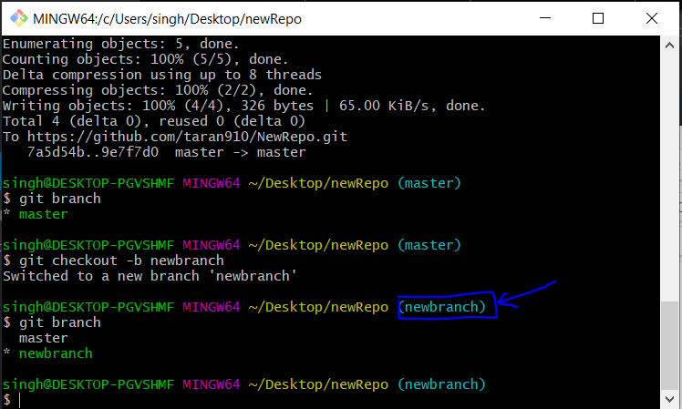
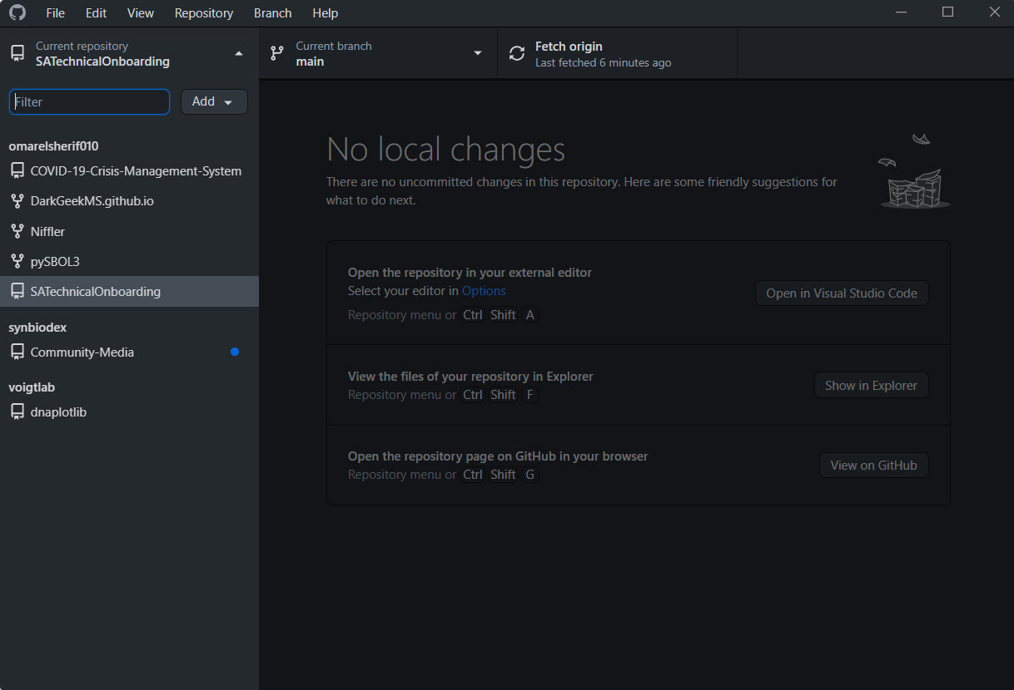
Git Bash GitHub Desktop

Slide 18

Workshop walk-through
Fork a repo, create a branch, make a change, push it, delete branch

Slide 19
Resources

Slide 20

Resources
GitHub Learning Lab
Introduction to version control with Git - Learn | Microsoft Docs
Introduction to GitHub - Learn | Microsoft Docs
Complete Git and GitHub Tutorial – YouTube (Kunal Kushwaha)
Learn Git and Github - YouTube (Elzero Web School)

Slide 21
Have a look at open source project (Face-X)

Slide 22
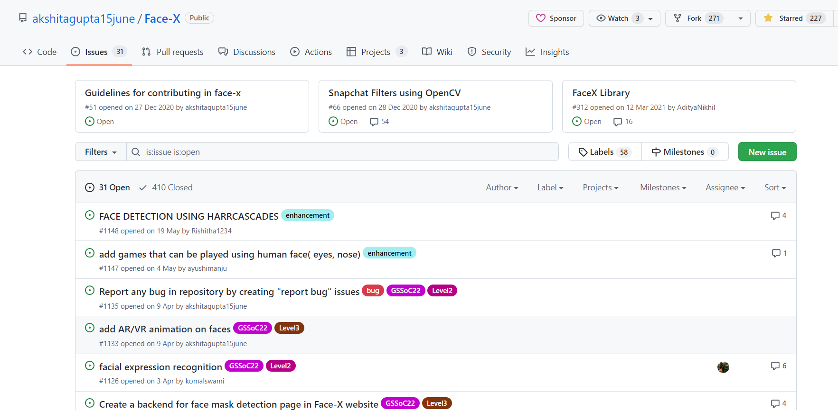

Slide 23
Questions

Slide 24

Thanks for attendance

